Slide 1
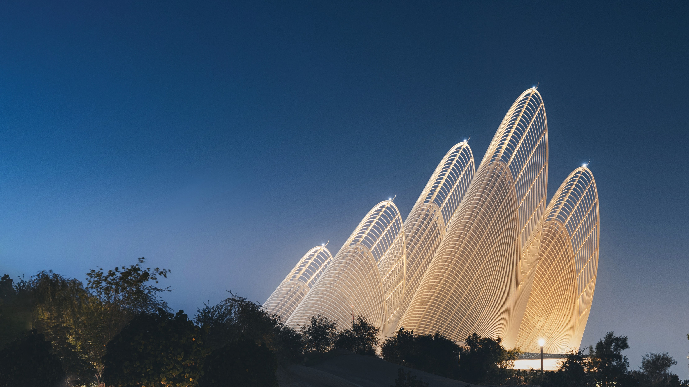
TROJAN CONSTRUCTION HOLDING
CONSTRUCTION HOLDING
Elevating Potential For Building Sustainable Communities

Slide 2

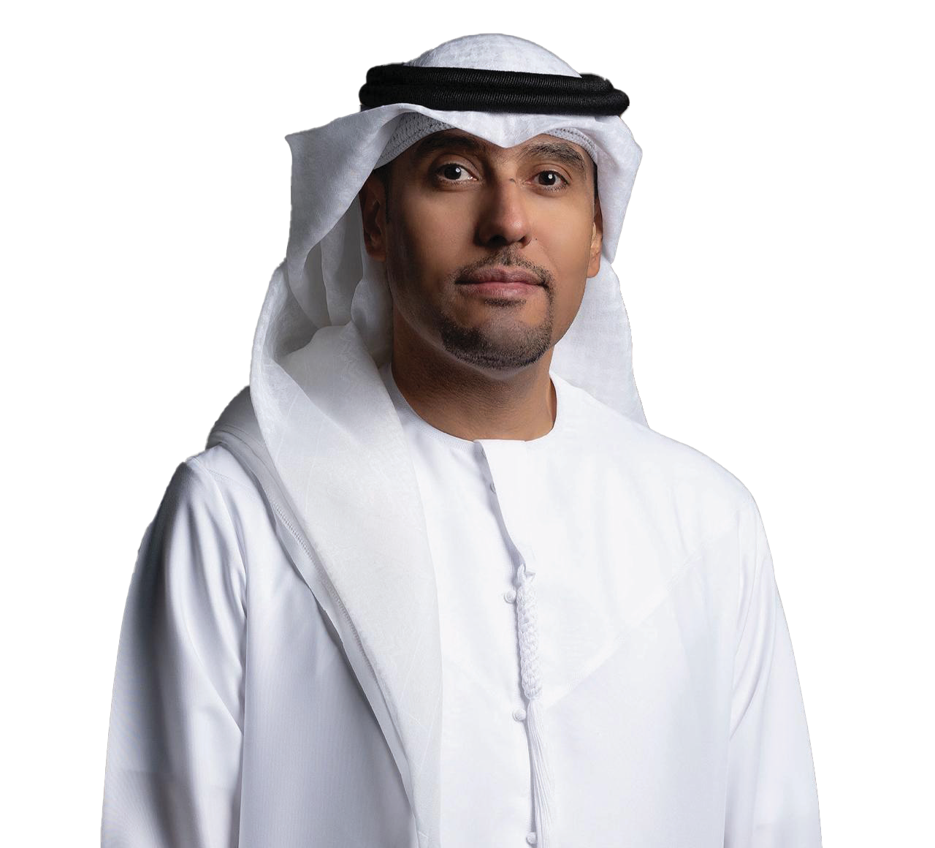

Group CEO Message
Beyond our commitment to deliver iconic developments, Trojan Construction Holding aims to bring social and economic advancement to Abu Dhabi’s 2030 vision in the field of construction and to empower our community’s lives through projects that aim to make a difference.
In every project that we undertake, we are steadfast in our promise that we can do it all, and believe that our collective expertise and capabilities through our specialist companies enable us to provide a turnkey solution that adds value at every level - for the client, the project, our people, and the community.
Eng. Ahmed Al Shamsi
Group CEO of Trojan Construction Holding

Slide 3
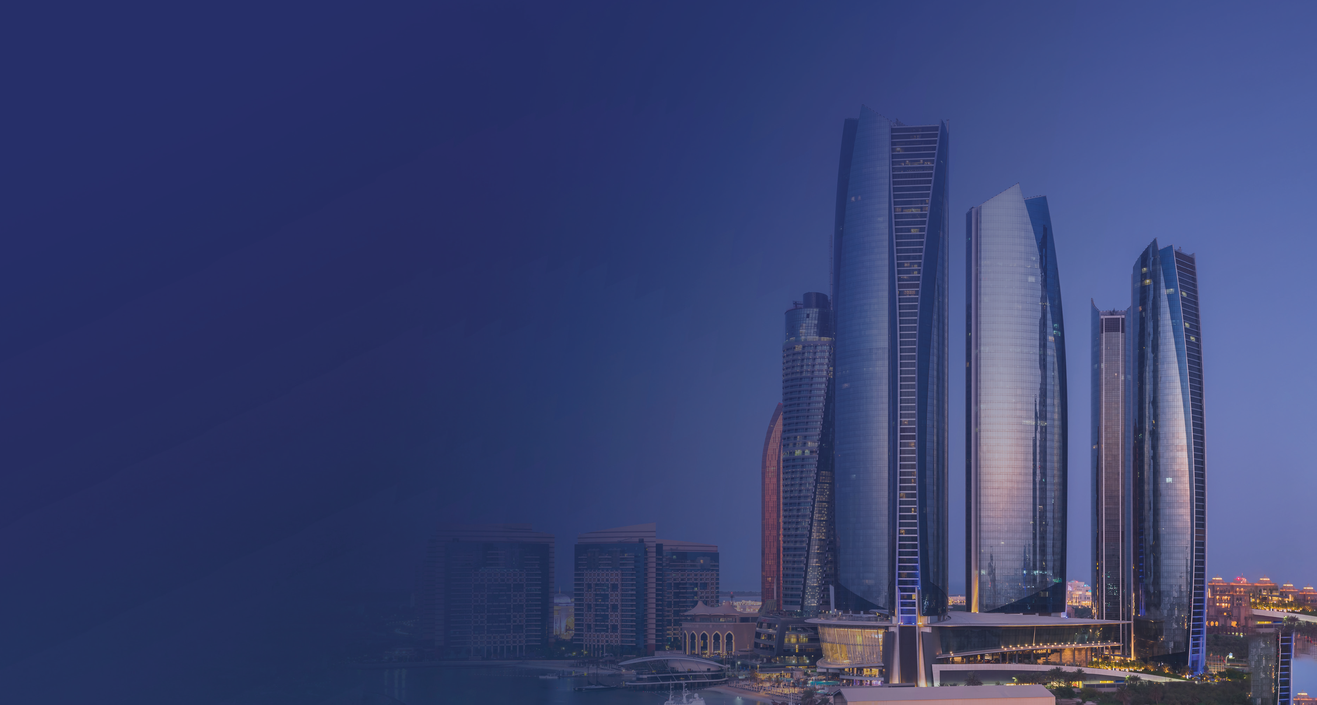


Trojan Construction Holding (TCH) is considered one of the fastest-growing groups in the construction sector in the UAE.
Today Trojan is one of the largest construction companies in the region, ranked No. 1 in the UAE and top 5 in GCC
A multidisciplinary Construction project portfolio with strong records to deliver Turn Key Projects in all segments
Expertise in Design, Build & Construct

Slide 4





























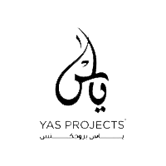









TCH
CONSTRUCTION HOLDING
SUBSIDIARIES
Trojan General Contracting
(Specialized in mass housing projects)
National Projects & Construction (Specialized in high-rise & infrastructure projects)
Royal Advance Electromechanical Works
(Specialized in electro-mechanical works)
Reem Emirates Aluminum & Glass Factory
(Specialized in glass facade & metal cladding)
Mais Interior Design
(Specialized in interior design)
Hitech Precast & Block Works Factory
(Specialized in mass housing projects)
Al Maha Modular Steel Structures
(Specialized in steel structure fabrication)
Phoenix Timber Factory
(Specialized in Interior Design)
Reem Ready Mix Concrete Factory (Specialized in concrete & plastering material)
Trojan Project Management Services
(Specialized in Project Management)
National Infrastructure Construction Company
(Specialized in Railway & Complex Networks)
7E
(Specialized in civilian CBRNE Shelters)
Yas Projects
(Specialized in UAE Government-focused projects)

Slide 5
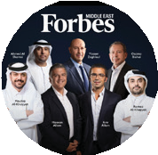
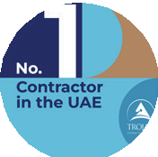
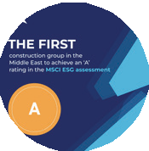
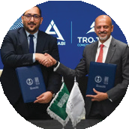
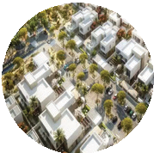
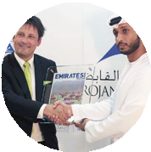
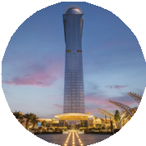
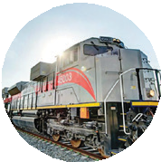
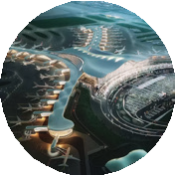

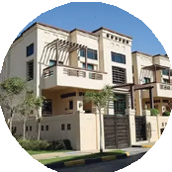
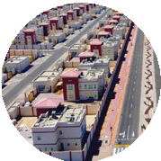
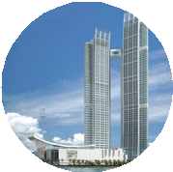
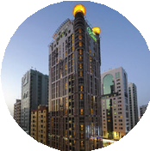
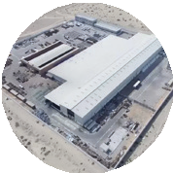

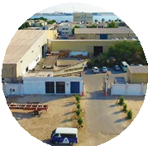
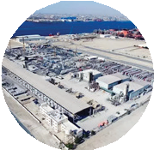
TROJAN CONSTRUCTION HOLDING MILESTONES
2026
Ranked Top 5 in Forbes Middle East Top 10 Construction Companies 2026
Ranked as the #1 Contractor in the UAE for three consecutive years
2025
Ranked among the Top 5 across the GCC by net value of work
2024
First construction group in the Middle East to achieve an “A” rating in the MSCI ESG assessment
2023
Etihad Rail completed KAFD Developments awarded
Zayed International Airport completed Baniyas West awarded
Al Samha 242 Villas awarded
2022
Kizad Logistics Warehouse completed Baniyas North completed
2015
Named “Contractor of the Year” by Emirates Project Magazine
2016
Palm Tower Project awarded
2019
Etihad Rail Stage 2 awarded
2021
Zayed International Airport Project awarded
Zayed National Museum & Guggenheim Museum awarded Trojan Holding rebranded under
Alpha Dhabi Holding & Trojan Construction Group
CONSTRUCTION HOLDING
2012
Trojan Holding established and subsidiaries consolidated under the holding structure
2011
Ain Al Fayda Housing Project awarded
2010
Emirati Housing Development Project awarded
2009
Nation Towers Project awarded Trojan General Contracting founded
2008
23-floor Vision Downtown completed by NPC
2000
Al Maha Modular founded
2003
National Projects & Construction (NPC) founded
2004
Royal Advance Electrical Works founded Phoenix Timber founded
2006
Reem Emirates Aluminum founded HiTech Concrete founded

Slide 6


RESOURCE STRENGTH
PLANT & MACHINERIES WORTH
OVER 2.8 BILLION
Over
56,000
TCH Workforce
Diversity
5.2% Emaratis
Specialists & Administration Managers / Supervisors 600 Engineers 1750
Technical 1500
Administrative 4900

Slide 7



COMBINED WORK PORTFOLIO
17 YEARS OF OPERATIONS WITH COMPLETED PROJECTS WORTH 40 BILLION.
More than 250 small to large projects executed
Achieved 1.25 billion
total man-hours without LTI
50 Billion+ current backlog
(Compound Annual Growth Rate)
CAGR 20.5%
Current revenue 14 BN by 2025

Slide 8
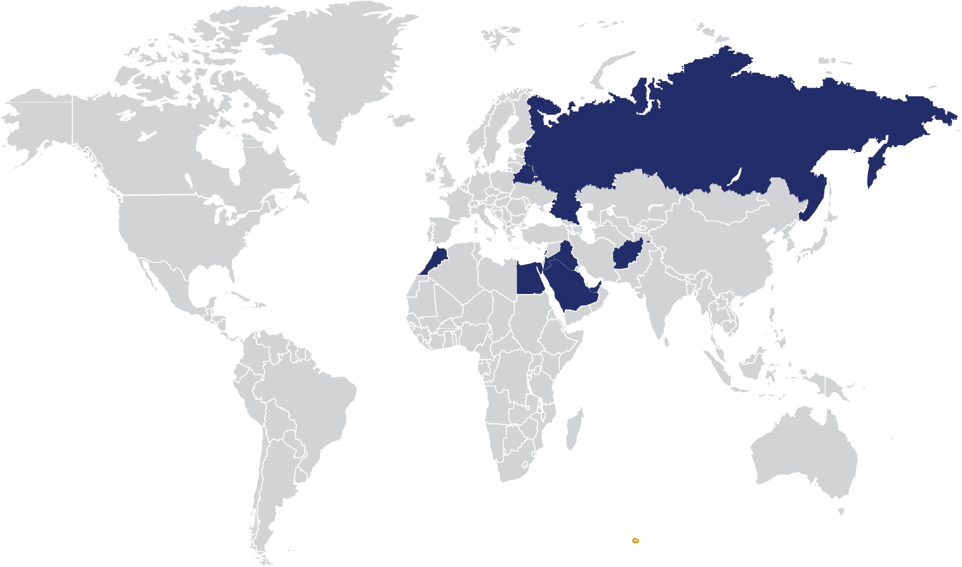





OUR PRESENCE A GLOBAL FOOTPRINT
Russia
Belarus
Iraq
Lebanon Jordan
United Arab Emirates
Egypt
Afghanistan
Seychelles
Projects
Morocco
Saudi Arabia

Slide 9
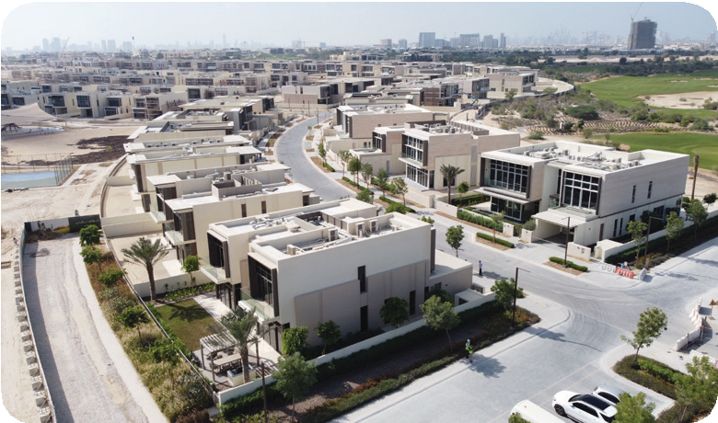
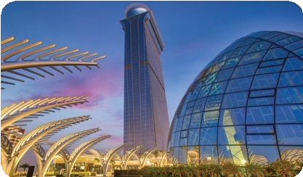
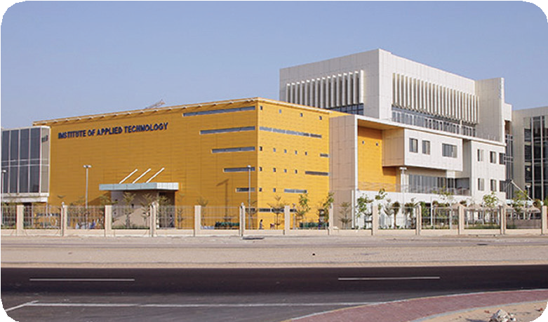
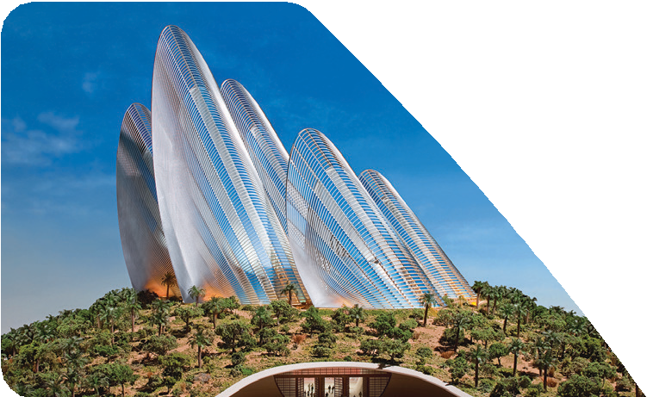
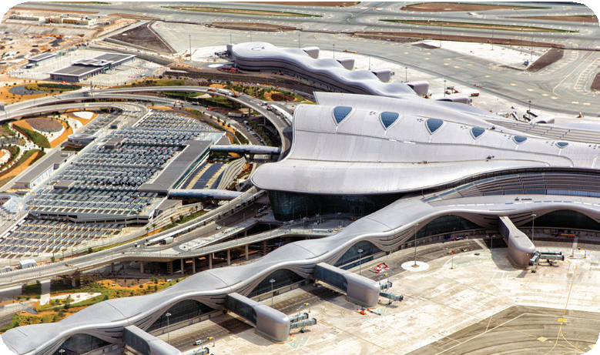
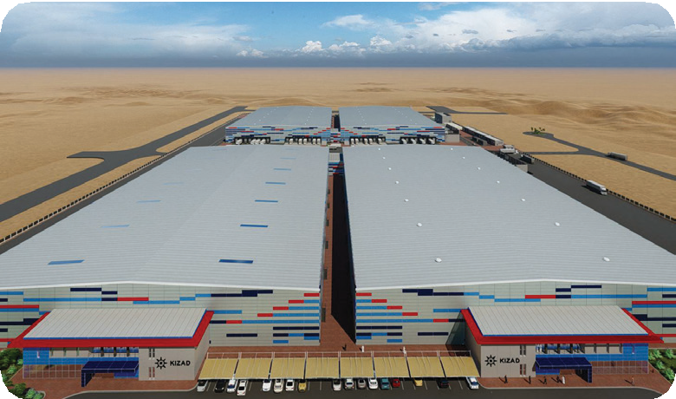
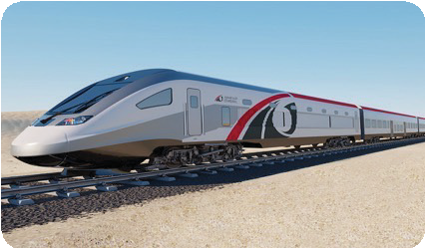
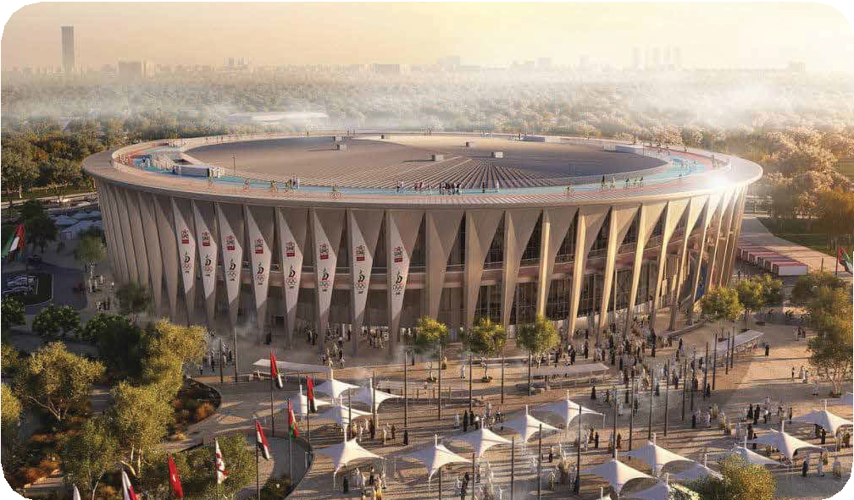
TROJAN KEY CAPABILITIES
MASS HOUSING
16,000 HOUSING UNITS
MIXED USED TOWERS
10 HIGH RISE TOWERS – 50 FLR (HOTELS, COMMERCIAL & RETAIL)
EDUCATION
EDUCATIONAL FACILITIES FOR 20,000 STUDENTS
MUSEUM
UAE’S 2ND LARGEST MUSEUMS
AIRPORT
UAE’S LARGEST AIRPORT TERMINAL OF 800,000 M2
INDUSTRIAL
LARGEST INDUSTRIAL WAREHOUSE IN KIZAD
RAIL
160 KM OF RAILWAY TRACK AND INFRASTRUCTURE
SPORT AND STADIUM
VELODROME DESIGN AND BUILD

Slide 10



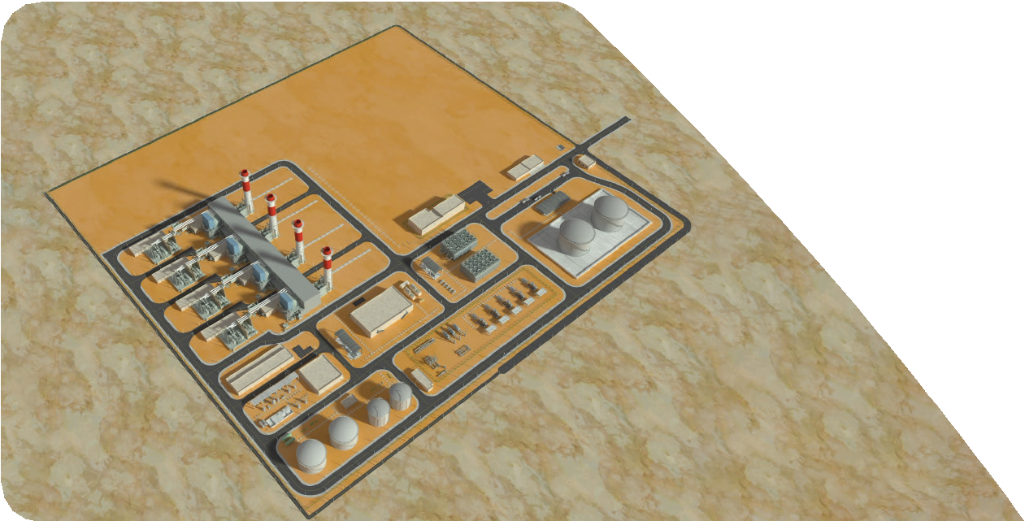


POWER AND UTILITIES BUSINESS UNIT
Al-Dhafra OCGT Plant
Awarded the prestigious 1,000 MW Open-Cycle Gas Turbine project in Abu Dhabi alongside Samsung C&T, scheduled for completion in 2027
$1.35 Billion Contract
Major EPC contract supporting UAE's ambitious AI-driven energy strategy and grid modernization initiatives
Advanced Technology
Strategic collaboration with Ansaldo Energia delivering cutting-edge gas turbines for critical infrastructure and peak power demand
This landmark project positions Trojan at the forefront of the region's energy transformation, delivering cutting-edge infrastructure that powers next-generation digital economies.

Slide 11
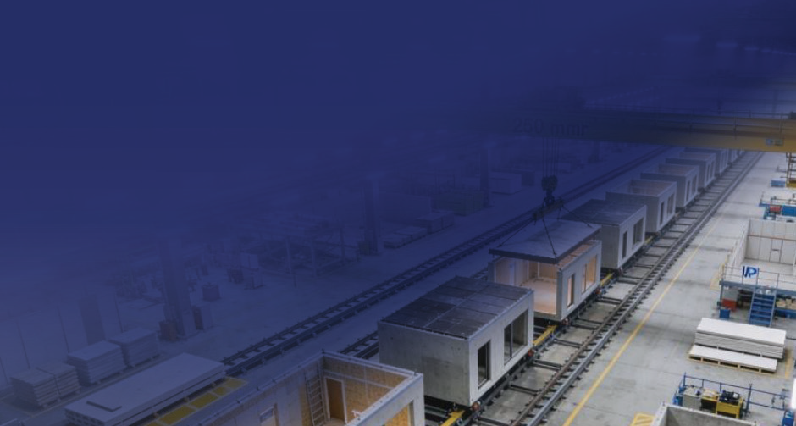


PRECAST MODULAR BUSINESS UNIT
Current Facility Utilization
Currently producing 4 villa per week using precast assembly modular method.
Current utilization is at project-based capacity (474 villas/year), with full production launch targeted for Q3–Q4 2026 to achieve 8-10 units per week capacity.
Strategic Roadmap
Milestone 1 (Q1–Q2 2026):
Complete factory infrastructure.
Milestone 2 (Q3–Q4 2026):
Install automated rail system and achieve 2–3 units per week.
Milestone 3 (2027):
Scale to full capacity.
Milestone 4 (2028–2030):
Achieve 1200+ annual villa capacity and regional market leadership.

Slide 12
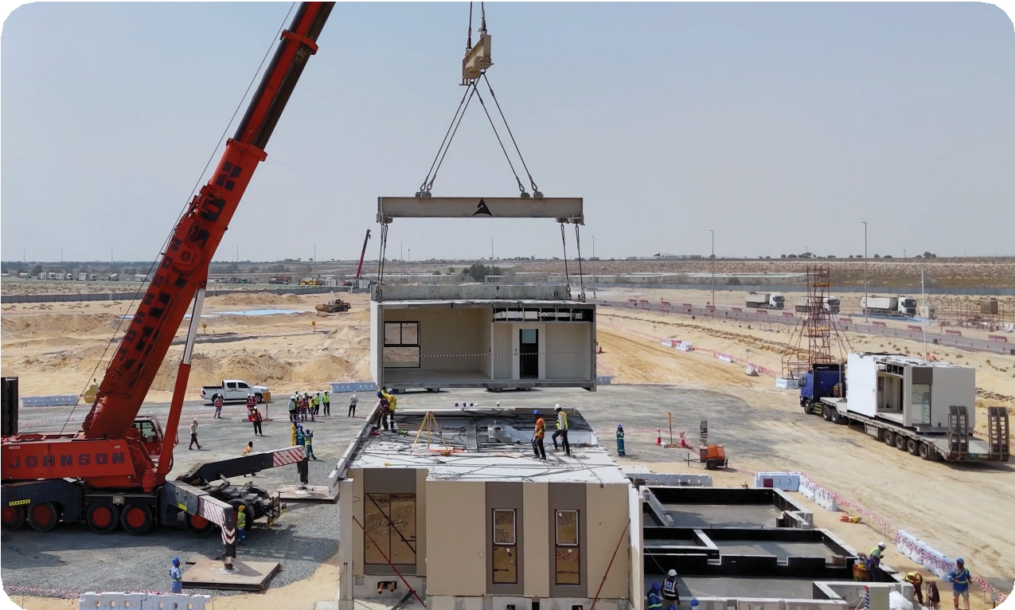
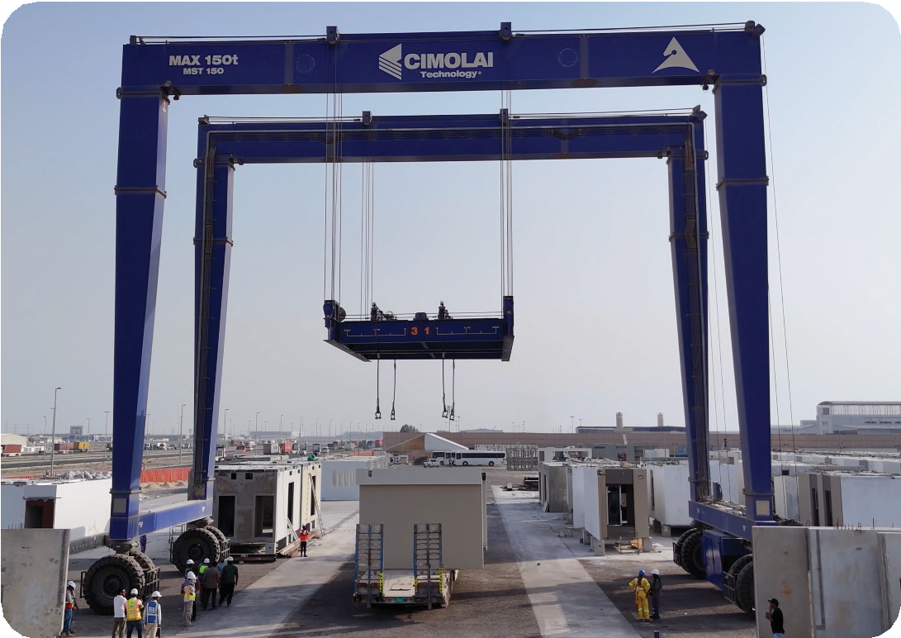
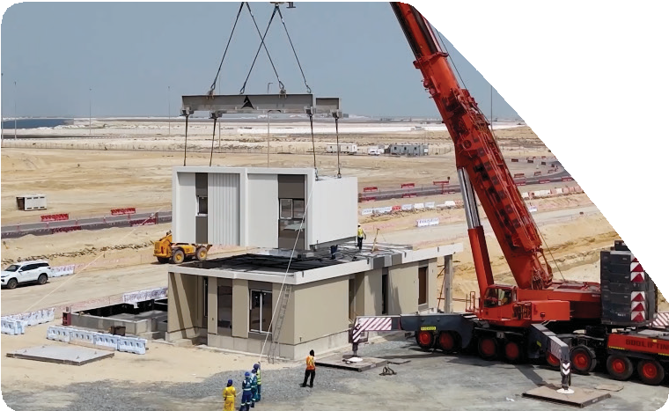
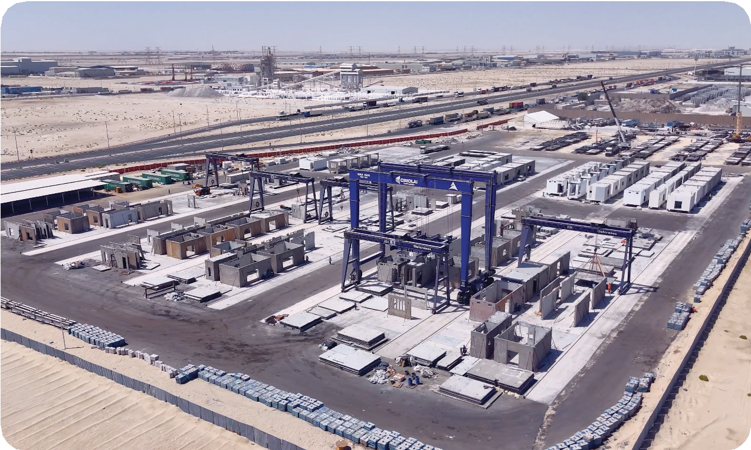
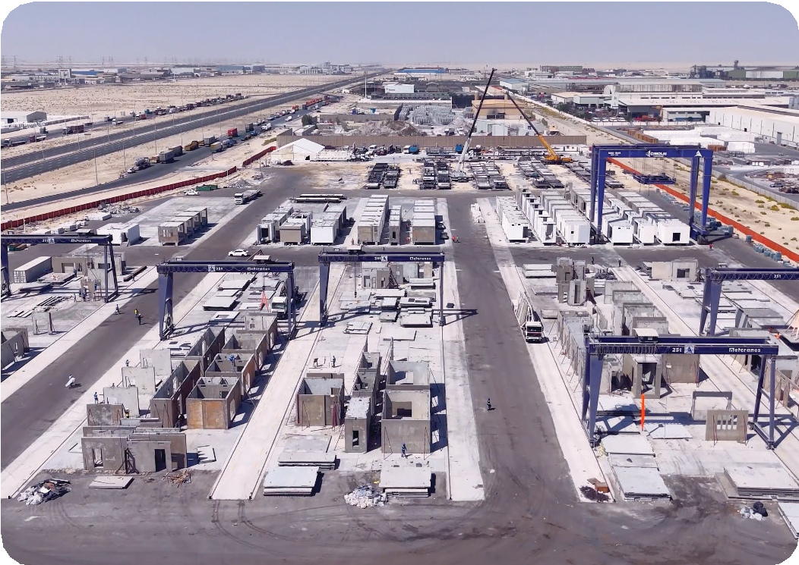
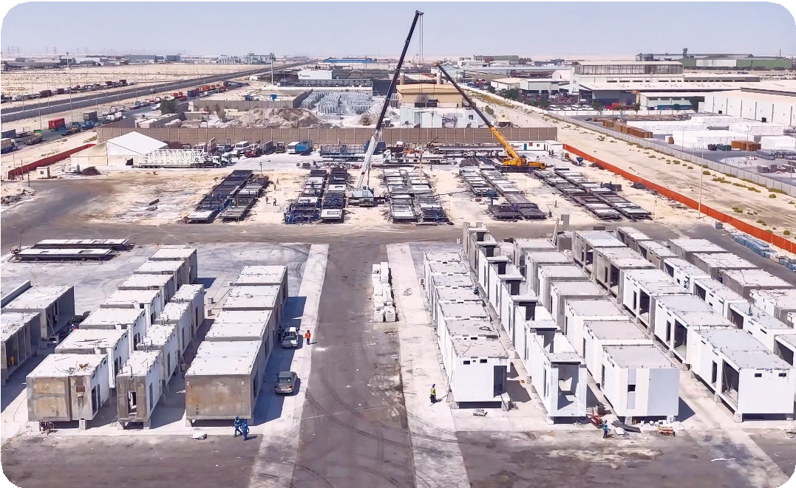
PRECAST MODULAR

Slide 13
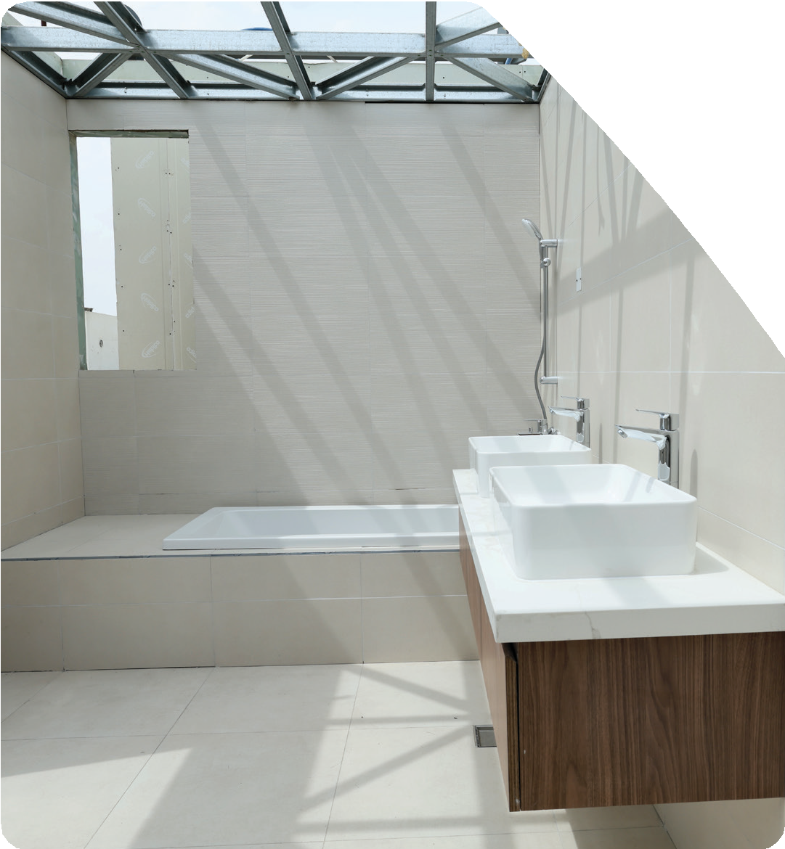
THE POD NEW BUSINESS INITIATIVE
SPEED AND EFFICIENCY, QUALITY AND CONSISTENCY, COST SAVINGS & SUSTAINABILITY.
POD bathrooms are used to improve quality, reduce site work, and speed up installation since they are manufactured in a controlled factory environment and delivered ready for installation. Currently we are working in 10 unites as mockup.
Plan with new production line to make 12 POD’s A DAY though ALMAHA steel Production line.

Slide 14

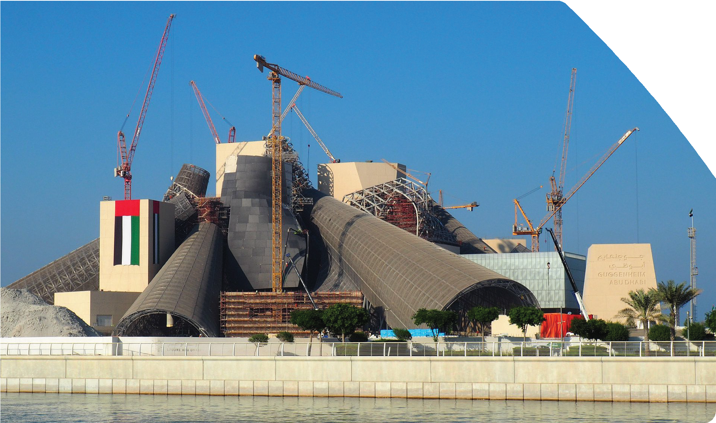
HIGHLIGHTS ONGOING KEY PROJECTS
Guggenheim Museum
Construction of Guggenheim Museum including testing and maintenance.
Project Category: Culture-Education
Location: Saadiyat, Abu Dhabi
Company: Trojan General Contracting LLC
Client: Department of Culture and Tourism

Slide 15

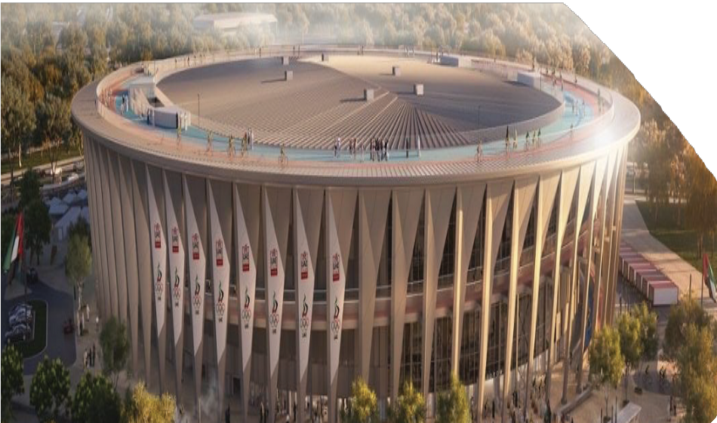
HIGHLIGHTS ONGOING KEY PROJECTS
Velodrome
Project: Velodrome
Location: Al Hudayrat, Abu Dhabi
Client: Modon
Design Consultant: Mott Macdonald, 1ST indoor cycling track in the region with a 600-meter cycling incline rising up along the external

Slide 16
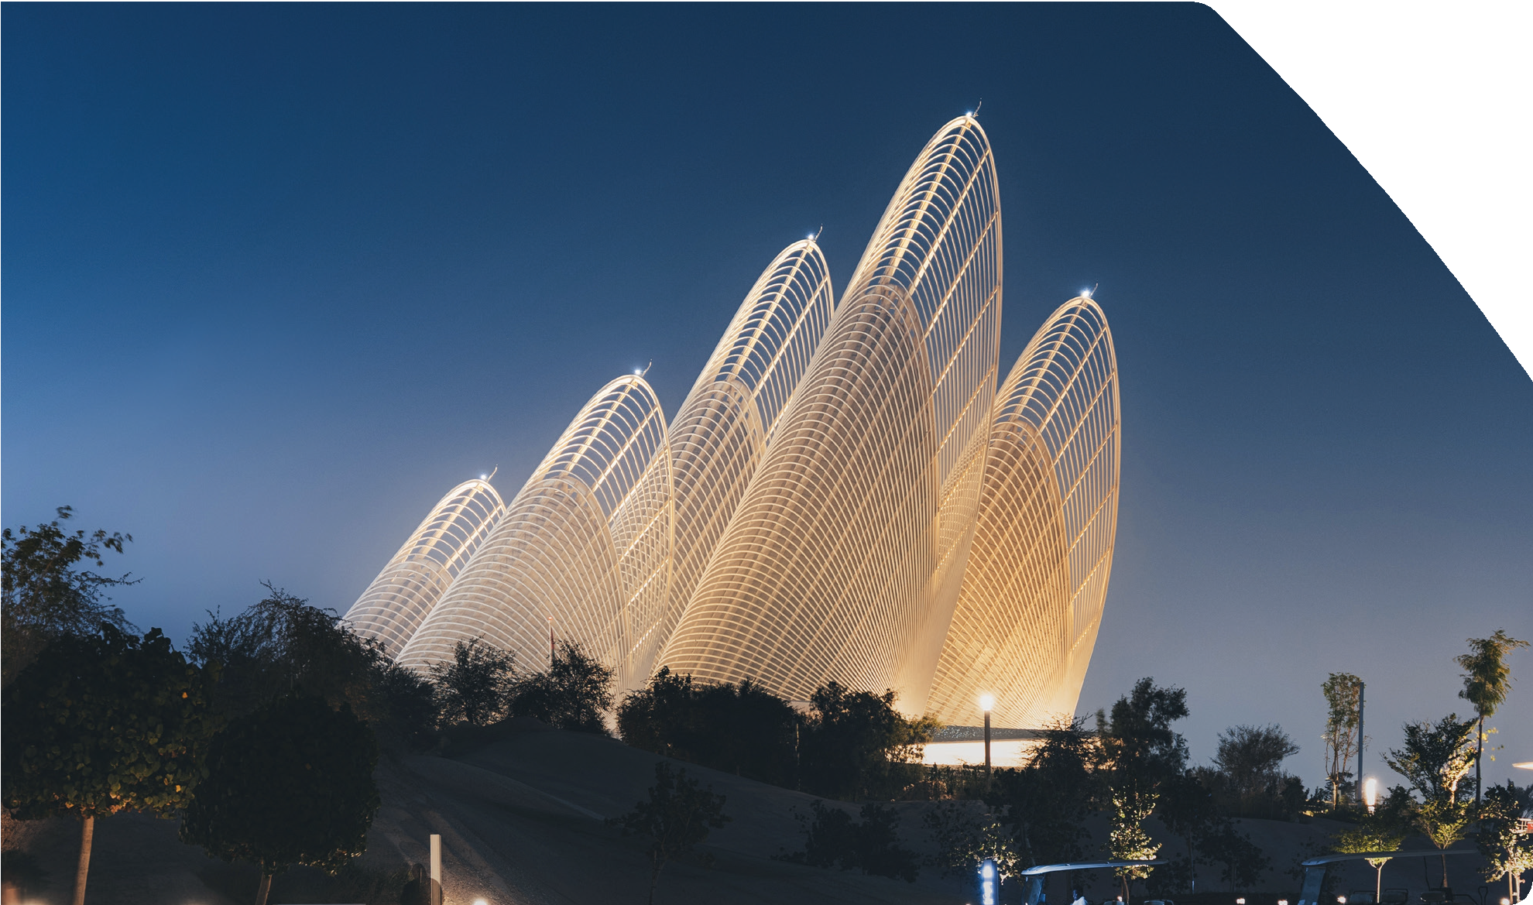
CULTURE
ZAYED NATIONAL MUSEUM
Construction of Zayed National Museum including testing and maintenance.
Project Category: Culture-Education
Location: Saadiyat, Abu Dhabi
Company: Trojan General Contracting LLC Client: Department of Culture and Tourism Completion by: 2025

Slide 17





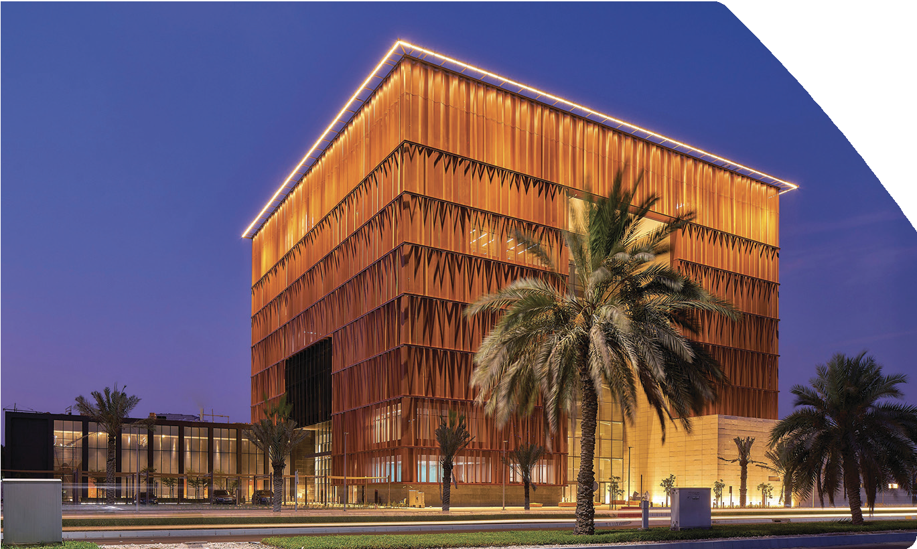
EDUCATIONAL
ANWAR GARGASH DIPLOMATIC ACADEMY
Location: Sector W59-02 , Abu Dhabi, UAE Client: Ministry of State Office Consultant: Shape Architecture
Practice & Research
Duration: 18 months
Status: Completed
Details: Construction, Execution, Completion, Testing, Commissioning, Maintenance , including remedying of any defects to the academic building, research center and the associated support facilities with surrounding landscaping. The total built up area is 18,490 m2

Slide 18
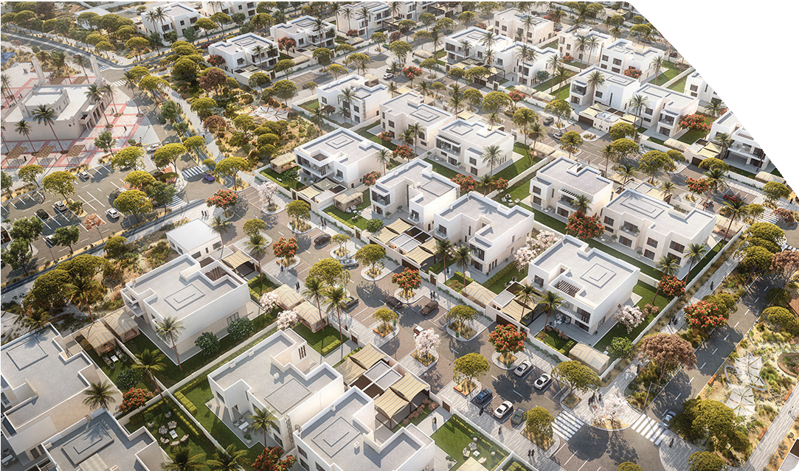
INFRASTRUCTURE
BANIYAS NORTH
Construction, Completion, Testing and Commissioning, Handover and Remedy of defect of construction of internal Roads and Infrastructure works for Baniyas North,
Abu Dhabi and all in accordance with drawings and specifications
Project Category: Infrastructure
Location: Baniyas, Abu Dhabi, UAE Company: National Projects & Construction Client: Aldar
Completion date: 2025

Slide 19
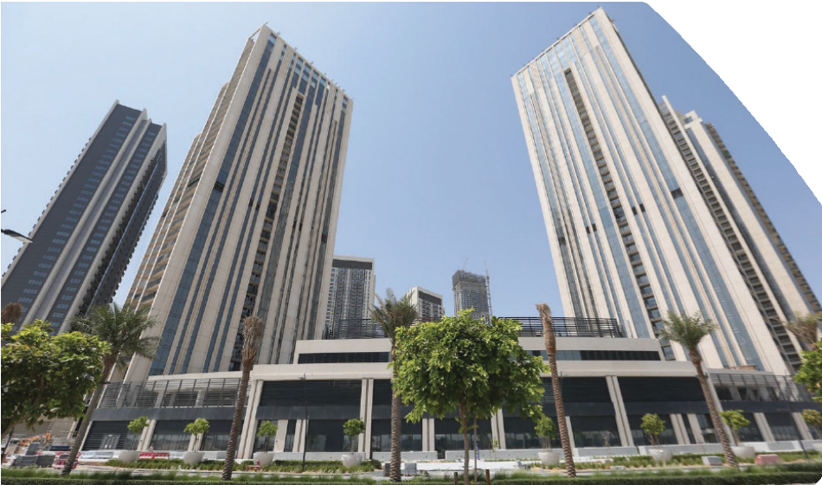
HIGH RISE BUILDINGS
HARBOUR GATE TOWERS
Location: Dubai Creek, Dubai, UAE Client: The Lagoons Phase 1 LLC Consultant: SSH Design LLC Duration: 28 Months
Status: Completed
Details: Construction, Execution, Completion, Testing, Commissioning, Maintenance, including remedying of any defects of Two(2) nos. residential towers (37 & 31 floors, villas and amenities block, common podiums, basement and includes external works, external services and hard and soft landscaping at Plot 30, Dubai Creek Harbour Development, Dubai. The total Built-Up Area for the project is approximately 105,000 sqm.

Slide 20
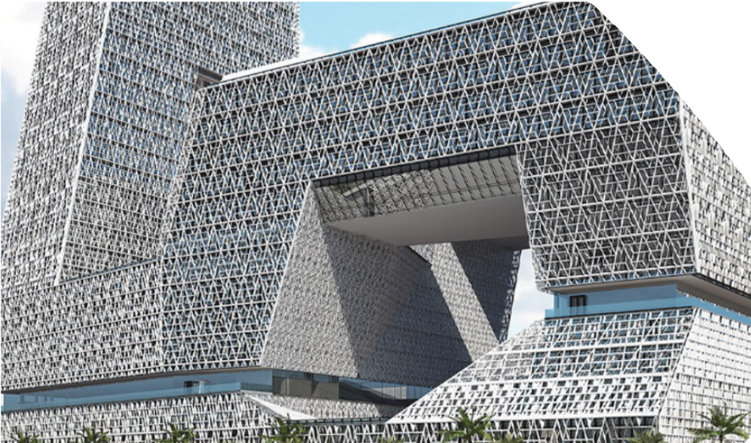
COMMERCIAL
THE SABIC JUBAIL MAIN BUILDING
Design Development, Engineering , Structural Calculation, fabrication, delivery of Facade and Associated works to site.
Project Category: Commercial
Location: KSA
Client: SABIC

Slide 21
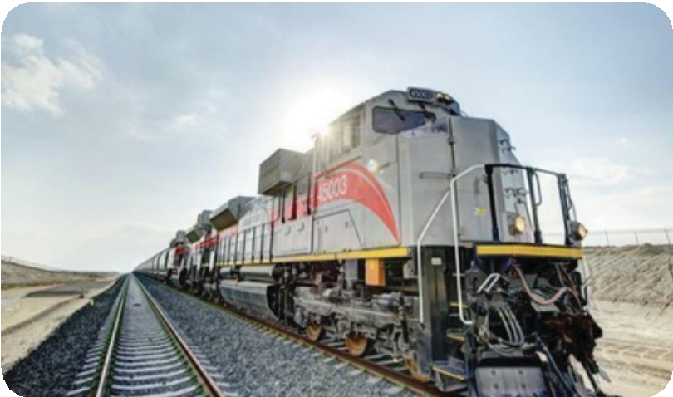
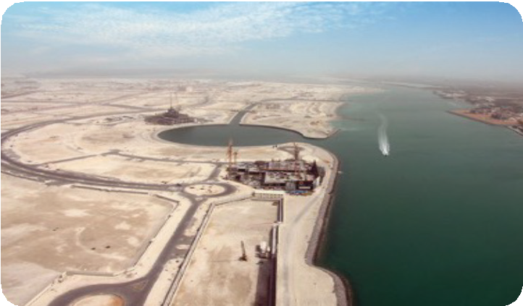
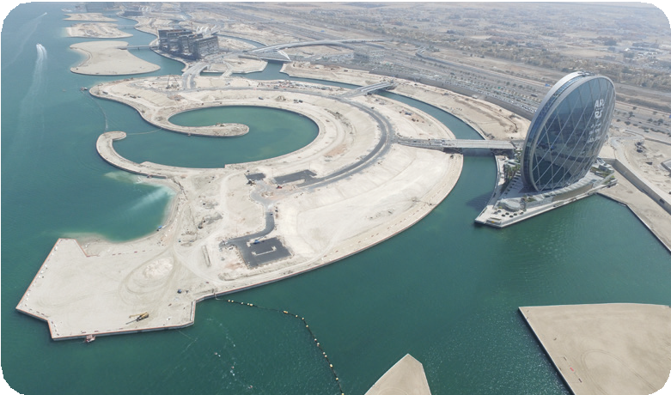
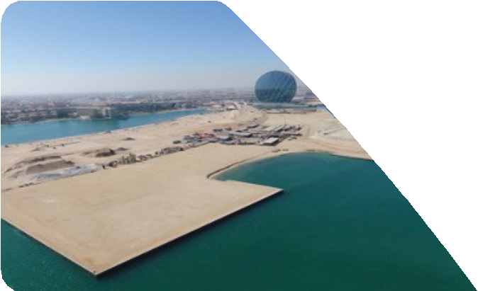
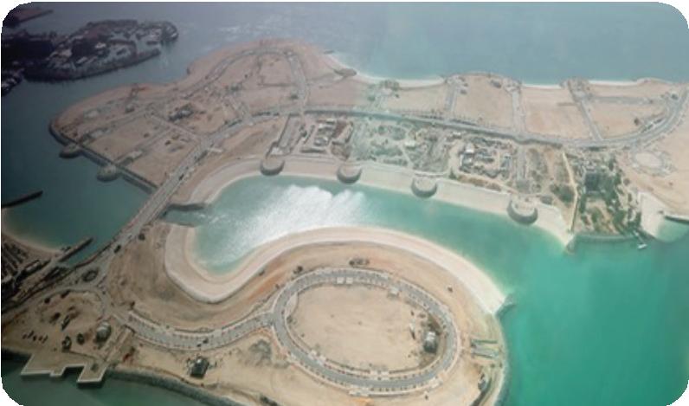



MAJOR INFRASTRUCTURE PROJECTS
ETIHAD RAIL STAGE II
SHARJAH
NAJAMT ROADS & UTILITIES
ABU DHABI
AL DANA PHASE II
ABU DHABI
LU’LUAT RAHA BRIDGE
ABU DHABI
NAREEL ISLAND
ABU DHABI
RIYADH CITY SOUTH PHASE 1 & 2
ABU DHABI
AL SADER AREA
ABU DHABI
AL MERIEF INFRASTRUCTURE
ABU DHABI

Slide 22





INFRASTRUCTURE
Etihad Rail – Stage 2
Location: Sharjah, Fujairah Client: Etihad Rail PJSC Consultant: Jacobs Holding Duration: 48 Months
Status: Completed
Details: Rail Track, Bridges & Underpasses, Tunnels, Road Works, Utilities and Misc. Buildings.
Value: 4.616 billion

Slide 23




LIST OF TRACK WORKS
Description | Numbers | Length
Tunnels | 9 | 6,813m
Bridges | 89 | 11,200m
Rail Tracks | - | 108,677m

Slide 24


INFRASTRUCTURE
Al Dana Phase II Infrastructure Works
Location: Al Raha Beach, Abu Dhabi Client: Aldar Properties PJSC Consultant: Hyder Consulting Duration: 11 months
Status: Completed
Details: Construction, completion & maintenance of marine works, road works, electrical works, water works, telecom works, sewerage works, surface water works, irrigation works, gas works, central waste management facility, district cooling piping works,
3 bridges works and sewerage pumping station.

Slide 25




LIST OF TUNNELS
Description | Numbers | Length
Tunnels | 9 | 6,813m
Bridges | 89 | 11,200m
Rail Tracks | - | 108,677m
Tunnel 1 | 1783
Tunnel 2 | 406
Tunnel 3 | 1299
Tunnel 4 | 308
Tunnel 7 | 1105
Tunnel 8 | 274
Tunnel 9 | 328
Tunnel 10 | 987
Tunnel 11 | 323
Total Tunnel Length | 6813 m

Slide 26








LIST OF BRIDGES
Description | Numbers | Length
Tunnels | 9 | 6,813m
Bridges | 89 | 11,200m
Rail Tracks | - | 108,677m
Section Name
UBR
UDP
OBR
UTL
 | Nb. | Length(m) | Nb. | Length(m) | Nb. | Length(m) | Nb. | Length(m)
DMC | 0 | 0 | 0 | 0 | 13 | 502 | 0 | 0
DMD | 4 | 433 | 5 | 90 | 1 | 18 | 3 | 80
PSA | 1 | 240 | 3 | 55 | 1 | 18 | 5 | 80
HUR | 20 | 3571 | 12 | 271 | 3 | 265 | 3 | 101
KFK | 7 | 5055 | 3 | 103 | 2 | 270 | 3 | 48
Total | 32 | 9299 | 23 | 520 | 20 | 1072 | 14 | 309
Total (w/o KFK) | 25 | 4244 | 20 | 416 | 18 | 802 | 11 | 261

Slide 27

INFRASTRUCTURE
Nareel Island Infrastructure & Public Realm
Location: Al Raha Beach, Abu Dhabi Client: Aldar Properties PJSC Consultant: Hyder Consulting Duration: 11 months
Status: Completed
Details: Construction, completion & maintenance of marine works, road works, electrical works, water works, telecom works, sewerage works, surface water works, irrigation works, gas works, central waste management facility, district cooling piping works, 3 bridges works and sewerage pumping station.

Slide 28

HSE PERFORMANCE
Join the Contractor Safety Partnership (CSP), organized by ADNOC at ADIPEC
LTFIR - TGC VS IOGP
0.28
0.22
0.24
0.24
0.09
0.07
0.02
0.02
2021
2022
2023
2024
TCG
IOGP
 | 2021 | 2022 | 2023 | 2024 | 2025
Manhours | 69728880 | 85555420 | 107850410 | 101237760 | 128606400
Fatality | 0 | 0 | 0 | 0 | 0
LTIs | 2 | 6 | 2 | 2 | 1
LTIFR | 0.09 | 0.07 | 0.02 | 0.02 | 0.01
Waste Recycling (in%) | 82 | 86 | 85 | 88 | 93.78
TGC Waste Recycling VS ESTIDAMA TARGET
TGC
Recycling Rate
86.96%
Estidama Target
80%
Waste Reduction Rate
(tonnes of waste per 100m²)
14
14
12
11
12

Slide 29









ESG - BEYOND COMPLIANCE
RECOGONITON OF EXCELLENCE
GOLD

Slide 30

CSR
We're a company that takes pride in our strong company culture and social initiatives – it's a way in which we become one with the community, empowering our employees to do social good and embrace diversity by being kind and open-minded.
Under our initiative 100 Trojan Young Engineers, we host engineering students from different universities. Students will be encouraged to grasp the day-to-day activities and gain an insight into how work will be after university, through a rich program including construction site tours.

Slide 31



CSR
Share Initiative
Through Share – our initiative which began in 2017 as part of the 'Year of Giving' campaigns, thousands of items, including of clothing and children's toys, have been donated to less fortunate families across the UAE. We've placed collection boxes in various locations across the city to encourage members of the public to donate clothes and toys for those affected by natural disasters.
The Year Of Zayed
The Year of Zayed was a year of initiatives, programs, and events, reflecting the great achievements of the late Sheikh Zayed. As a part of that initiative, we've launched, "We Grow With Zayed" initiative – aiming connect thousands of people in their shared gratitude and love for the UAE.

Slide 32



CSR
Tree Planting Initiative
Through our Tree Planting Initiative we supported in the plantation of 23,000 native trees, the Salvadora persica (the Arak tree), and the Prosopis cineraria (the Ghaf tree)., under our vision of “Together towards zero footprint”. This green dream was made possible through our fruitful collaboration with the EAD Environment Agency and Sharjah Municipality.
The program brought life to the desert with a touch of green and paid tribute to the heritage of this nation. The event was a tremendous success, not only among our stakeholders, but it also extended from local authorities and across borders, to our employees’ families back in their home countries.
Blood Donation Initiative
Under our Blood Donation initiative called as “ A drop for you, an ocean for others” in collaboration with Al Dhaid Hospital Blood Bank in Sharjah and Blood Bank in Khalidyiah, Abudhabi, we saw our Trojan
family come forward to achieve a successful collection of 500L of blood in a span of 22 donation drive events. Our program saw a successful turnout of more than 1250 donors across the group and subsidiaries that volunteered, in pursuit of giving back to the community we aim to continue this successful effort.
Plantation
It is important to give back to the environment that supports us, which is why we have organized plantation drives to plant trees. We partnered with local entities such as EAD and Sharjah Municipality to plant a variety of trees that are native to the region. Our dedicated teams worked hard to plant 23,000 native trees. Through this, we are bringing shade to our areas, while creating a habitat for local wildlife. Our efforts reflect our commitment to reduce carbon footprint, while moving forward towards a sustainable future.

Slide 33


CSR
Clean-Up Drives Initiative
In pursuit of a cleaner city, We at Trojan have organized a series of clean-up drives with our Trojan Family across the locations of Saadiyat Island Residential, Yas Island Beach area, Saadiyat Island Beach and Sharjah Parks. This effort has resulted in a total of 8500 hours spent cleaning and collecting more than 15 Tons of waste across the above locations. Our team was refreshed knowing that the city of tomorrow is now one step closer to being clean for all who reside in it.
In line with the continuous efforts to improve the safety culture, we have achieved 157 million LTI free man hours in 2022. Creating an environment that values safety is a core thought for all our leaders on-ground and that is something we are determined to stay on-course and maintain for our Trojan Family.
Waste Reduction
We are committed to reducing our environmental impact through our waste reduction and recycling efforts by implementing a new waste management system. As such, our waste recycling has increased to 78%, while our waste reduced to 12 ton/100 square meters.

Slide 34
CONSTRUCTION HOLDING
Trojan Construction Holding
P.O. Box 111059, Abu Dhabi, UAE Tel: +971 2 509 7300
www.trojanholding.com

